Slide 1

Graph Algorithms in
Bus Network Optimization
Analysis of Algorithms — Final Project
Team Members: Rodrigo Molero, Thomas Gabriel, and David Fletcher

Slide 2

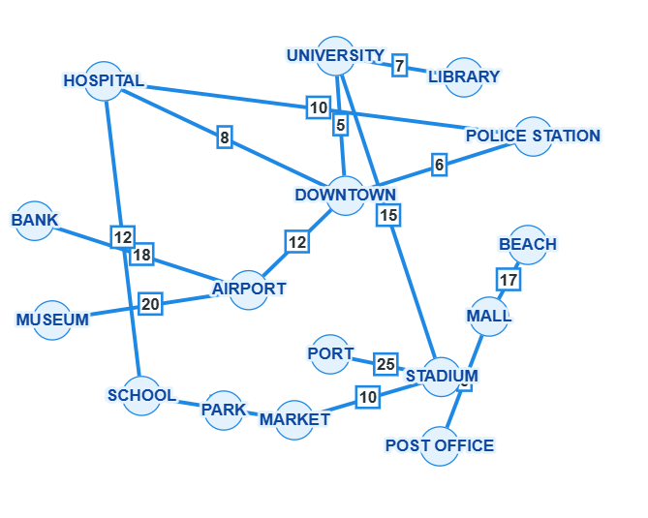



Problem Formulation & Graph Modeling
Real-World Problem
Bus Network Graph (16 Vertices, 20 Edges)
Optimizing a city bus transit network to find the fastest routes, minimum spanning connections, and efficient traversal orders between 16 bus stops.
Vertices
16 bus stops (Downtown, University, Airport, Mall, Hospital, etc.)
Edges
Travel routes between stops weighted by travel time (minutes)
Graph Type
Undirected, Weighted — bidirectional bus routes with travel times

Slide 3

Graph Construction & Dataset
Main Network
Small Sparse
Large Sparse
16 vertices | 20 edges
5 vertices | 4 edges
16 vertices | 8 edges
Full bus network with all routes and travel times
Minimal connections for baseline comparison testing
Moderate sparsity for scaling and disconnection tests
Implementation: Adjacency Matrix
16×16 matrix storing travel times. Zero indicates no direct route. Synthetic dataset models a realistic city bus network.

Slide 4


Algorithm: BFS & DFS Traversal
Breadth-First Search (BFS)
Depth-First Search (DFS)
Pseudocode:
BFS(graph, start):
mark start visited
enqueue start
while queue not empty:
curr = dequeue()
process curr
for each neighbor of curr:
if not visited:
mark visited, enqueue
Time: O(V²) — adjacency matrix
Space: O(V) — queue + visited array
Pseudocode:
DFS(graph, visited, curr):
mark curr visited
process curr
for each neighbor of curr:
if not visited:
DFS(graph, visited, nbr)
Time: O(V²) — adjacency matrix
Space: O(V) — recursion stack + visited

Slide 5
Algorithm: Bellman-Ford (Shortest Path)
Bellman-Ford Algorithm
Complexity
Time: O(V³)
(V-1 relaxations × V² edge checks)
Space: O(V)
(distance + predecessor arrays)
Pseudocode:
BellmanFord(graph, source):
dist[all] = INF; dist[source] = 0
repeat V-1 times:
for each edge (u,v,w):
if dist[u]+w < dist[v]:
dist[v] = dist[u]+w
pred[v] = u
check for negative cycles
Handles negative edge weights (unlike Dijkstra)
Best / Worst Case
Best: O(V²)
Sparse graph, early convergence
Worst: O(V³)
Dense graph, all edges relaxed each pass

Slide 6

Algorithm: Prim's MST
Prim's Minimum Spanning Tree
Complexity
Time: O(V²)
(linear scan for min — no heap)
Space: O(V)
(key + inMST arrays)
Pseudocode:
MST(graph, start):
key[all] = INF; key[start] = 0
repeat V-1 times:
u = vertex with min key
not yet in MST
add u to MST
for each neighbor v of u:
if w(u,v) < key[v]:
key[v] = w(u,v)
Builds tree by always adding cheapest edge
Best / Worst Case
Best: O(V²)
Dense graph — matrix scan efficient
Worst: O(V²)
Same — no shortcut for adj. matrix

Slide 7

Complexity Analysis Summary
Algorithm | Time | Space | Best Case | Worst Case
BFS | O(V²) | O(V) | O(V) | O(V²)
DFS | O(V²) | O(V) | O(V) | O(V²)
Bellman-Ford | O(V³) | O(V) | O(V²) | O(V³)
Prim's MST | O(V²) | O(V) | O(V²) | O(V²)
Note: All complexities assume adjacency matrix representation. With adjacency lists, BFS/DFS would be O(V+E) and Prim's with a min-heap would be O(E log V).

Slide 8

Experimental Analysis & Comparison
Bellman-Ford is significantly slower due to its O(V³) complexity. BFS, DFS, and Prim's all perform comparably for this graph size. Sparse graphs execute marginally faster due to fewer meaningful edge relaxations.

Slide 9

Discussion & Insights
Best Performer?
When to Use Each?
BFS and DFS are fastest for traversal. For shortest paths, Bellman-Ford provides correctness at the cost of speed. Prim's MST efficiently finds minimum-cost spanning networks.
BFS for level-order exploration and shortest unweighted paths. DFS for connectivity checks. Bellman-Ford when negative weights are possible. Prim's MST for network cost minimization.
Limitations
Key Observations
Adjacency matrix wastes memory on sparse graphs. BFS/DFS don't consider edge weights. Bellman-Ford's cubic time is impractical for very large networks.
Graph density has minimal effect at V=16 but would diverge significantly at larger scales. Disconnected subgraphs cause MST and traversal to produce incomplete results.

Slide 10
Conclusion
This project demonstrated how graph algorithms solve real-world transit optimization challenges. BFS and DFS provide efficient traversal, Bellman-Ford finds shortest weighted paths, and Prim's MST identifies minimum-cost network structures. The choice of algorithm depends on the specific problem constraints — speed, weight handling, and graph structure.
Thank You

